Slide 1
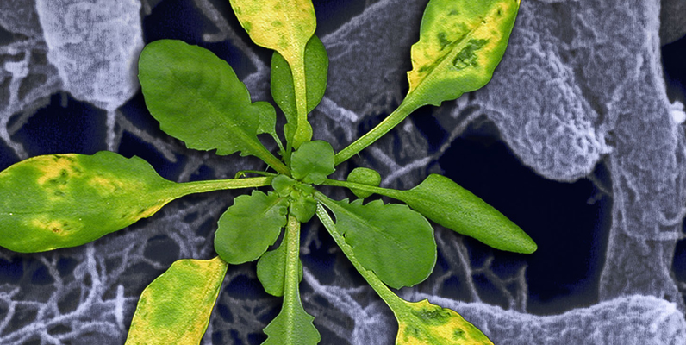
A Practical Study of Arabidopsis: Pseudomonas Infection in Plant-Microbe Interactions
Dr. Pingtao Ding
Jonathan Jones Group @ 2017 TSL Summer School

Slide 2
What do we know about Pseudomonas (P.)?
Gram-negative bacteria
Most Pseudomonas spp. are naturally resistant to penicillin
Contains both animal and plant pathogens
Animal pathogens:
P. aeruginosa (opportunistic pathogen)
P. oryzihabitans
P. plecoglossicida
Plant pathogens:
P. syringae (most are leaf-infecting microbes)
P. fluorescens (most are soil microbes)

Slide 3
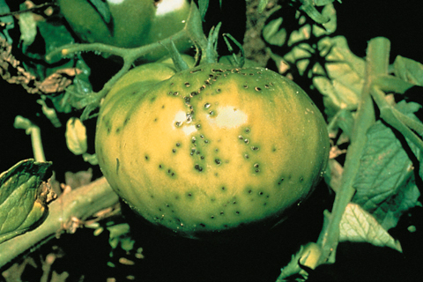
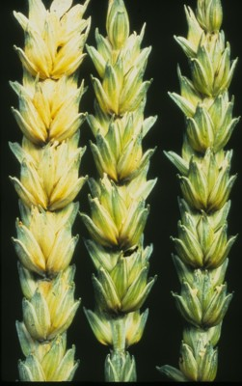
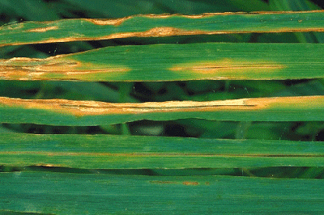
Why do we study P. syringae?
A. Bacterial speck on tomato fruit, caused by P. syringae pv. tomato
B. Stripe blight on wheat leaves, caused by P. syringae pv. striafaciens
C. Bacterial spots on oat grains, by P. syringae pv. atrofaciens
(A) Courtesy A. A. MacNab; (B) Beoff.j Thomas & Robert Loughman; (C) Courtesy K. Naumann
Notes:
Reading:
DNA relatedness among the pathovars of Pseudomonas syringae and description of Pseudomonas tremae sp. nov. and Pseudomonas cannabina sp. nov. (ex Sutic and Dowson 1959)
Authors: L. Gardan, H. Shafik, S. Belouin, R. Broch, F. Grimont, P. A. D. Grimont
Author for correspondence: L. Gardan. Tel: +33 02 41 22 57 29. Fax: +33 02 41 22 57 05. e-mail: gardan@angers.inra.fr
Int J Syst Evol Microbiol, April 1999 49: 469-478, doi: 10.1099/00207713-49-2-469
Subject: New Taxa - Proteobacteria
Published Online: 01/04/1999

Slide 4
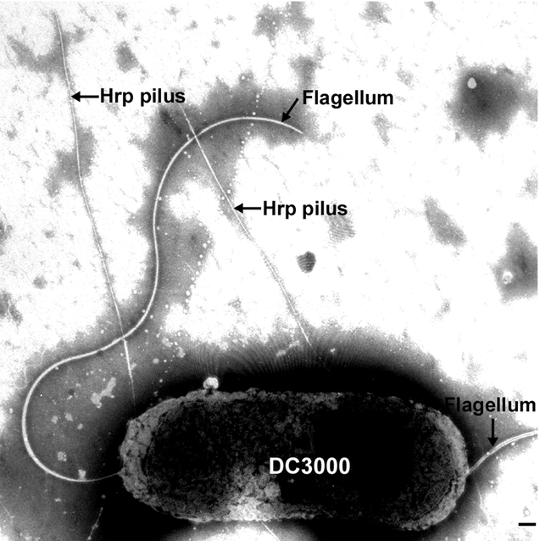
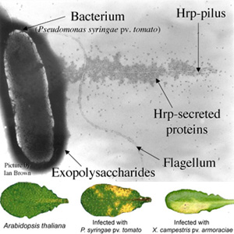
What does P. syringae look like?
Katagiri et al. 2002 Arabidopsis Book; Picture by Ian Brown

Slide 5
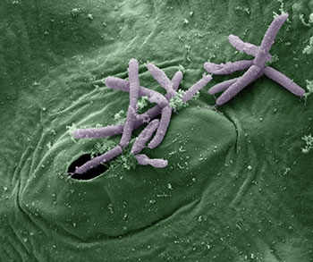
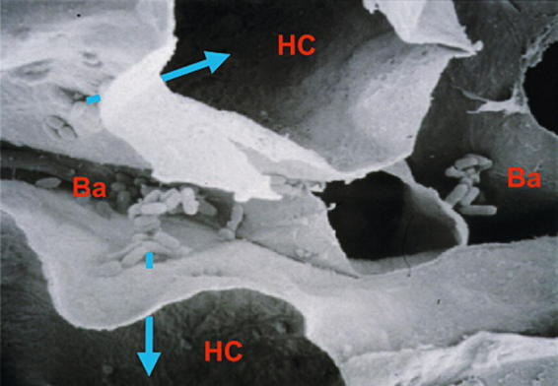
How does P. syringae infect plants?
Scanning electron microscopic picture:
HC= host cell;
Ba= bacteria.
Courtesy James Kremer & Sheng Yang He; Katagiri et al. 2002 Arabidopsis Book

Slide 6
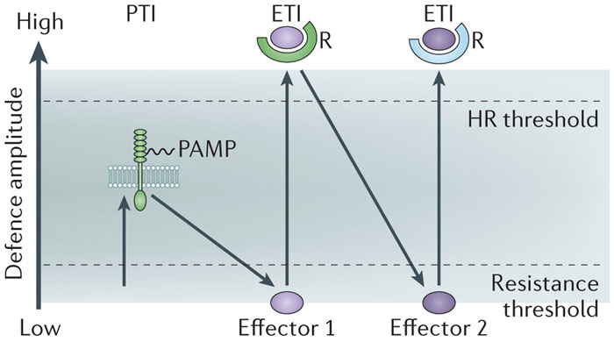
How does plants defend themselves against P. syringae?
“Zig-Zag” Model
PTI= PAMP-triggered immunity;
ETI= effector-triggered immunity
HR= hypersensitive response
Pumplin & Voinnet. 2013 Nat Rev Microbiol

Slide 7
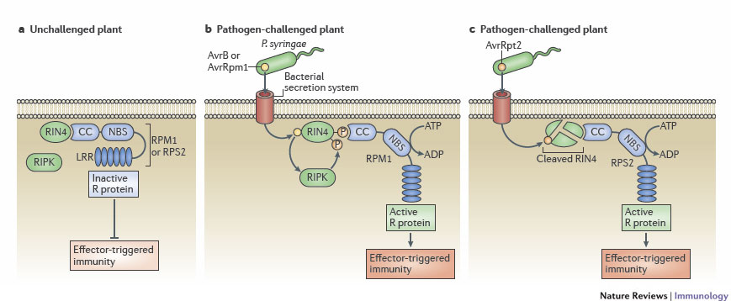
A case study for Arabidopsis-Pseudomonas interactions: AvrRps2/AvrRpm1→ETI
Spoel & Dong. 2012 Nat Rev Immunol.; Thomas & Thireault. 2009 Plant J

Slide 8
How do we use P. syringae in the lab for research purposes?
First of All:
To know how to infect plants using P. syringae in various lab conditions.
To know which way to choose according to specific research purposes;
To know how to quantify/qualify the results.

Slide 9
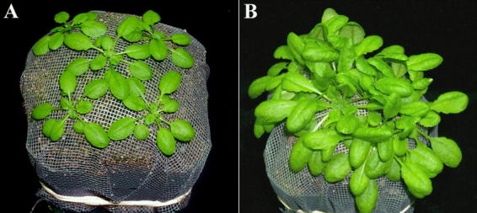
Dipping inoculation of P. syringae
Katagiri et al. 2002 Arabidopsis Book

Slide 10
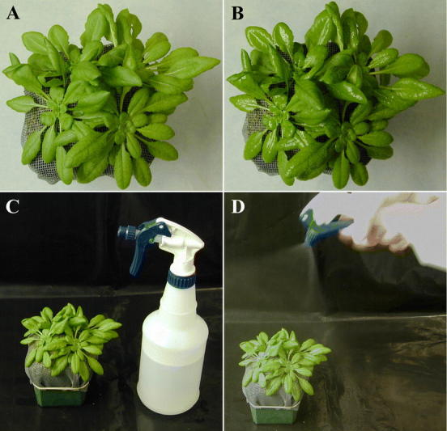
Spray inoculation of P. syringae
Katagiri et al. 2002 Arabidopsis Book

Slide 11
Dipping & Spray inoculation of P. syringae
Yao & Withers et al. 2013 Chapter 6, Jasmonate Signaling: Methods & Protocols

Slide 12
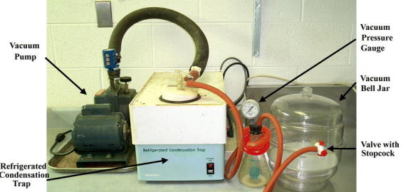
Vacuum inoculation of P. syringae
Katagiri et al. 2002 Arabidopsis Book

Slide 13
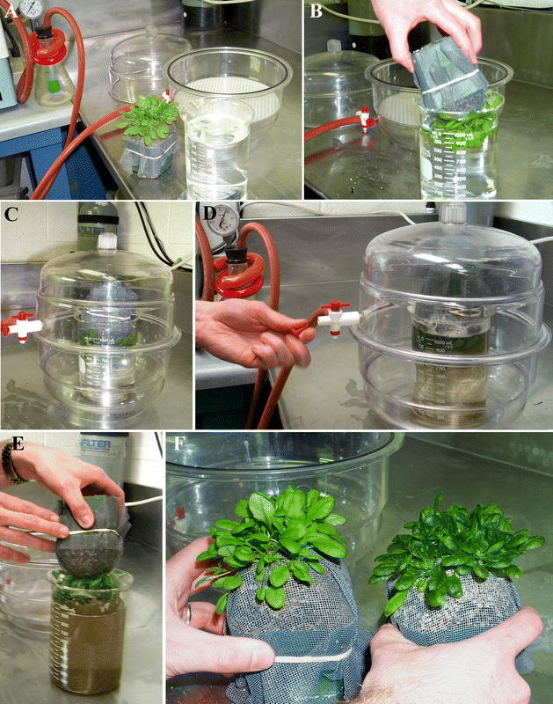
Vacuum inoculation of P. syringae
Katagiri et al. 2002 Arabidopsis Book

Slide 14
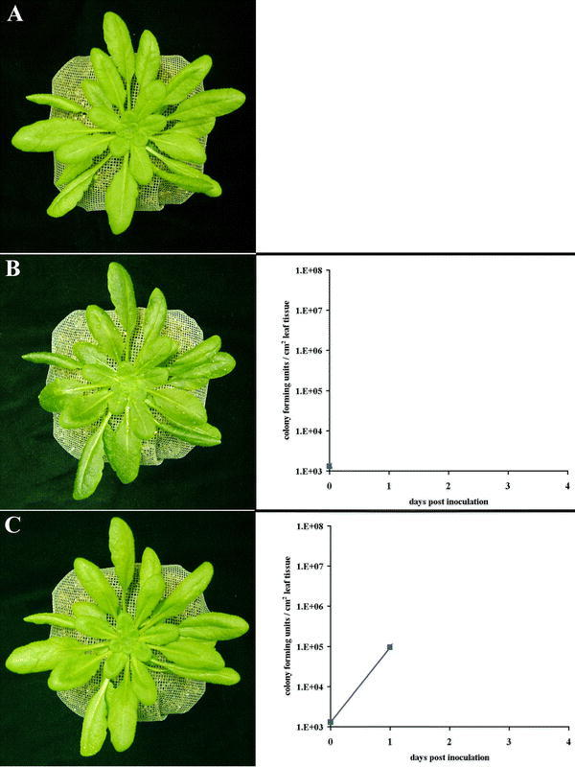
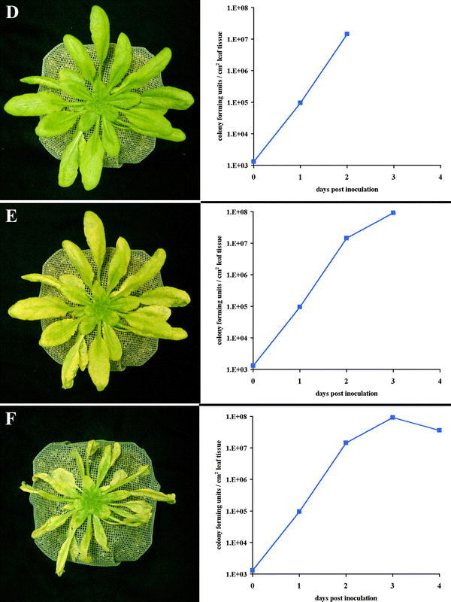
Qualify and quantify P. syringae growth
Katagiri et al. 2002 Arabidopsis Book

Slide 15
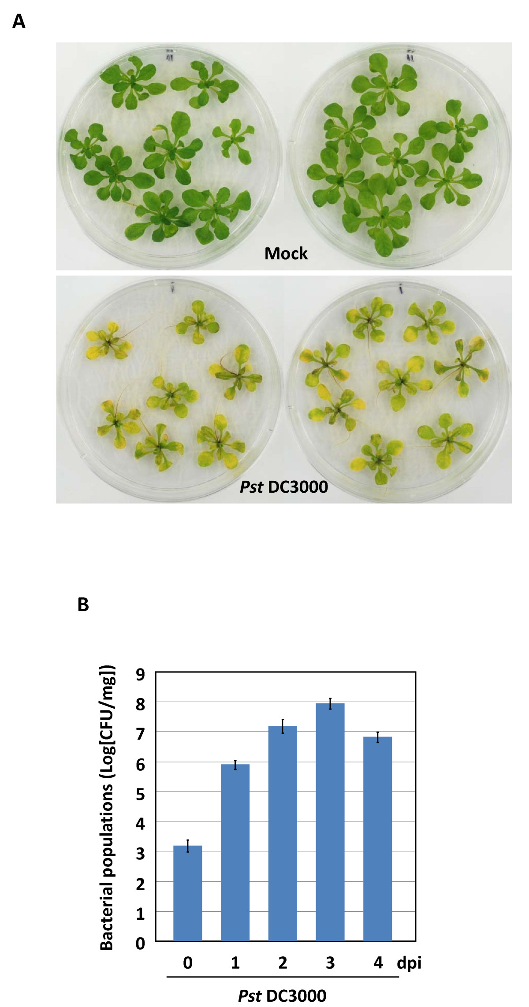
Flooding inoculation of P. syringae
Ishiga & Ishiga et al. 2011 Plant Methods

Slide 16
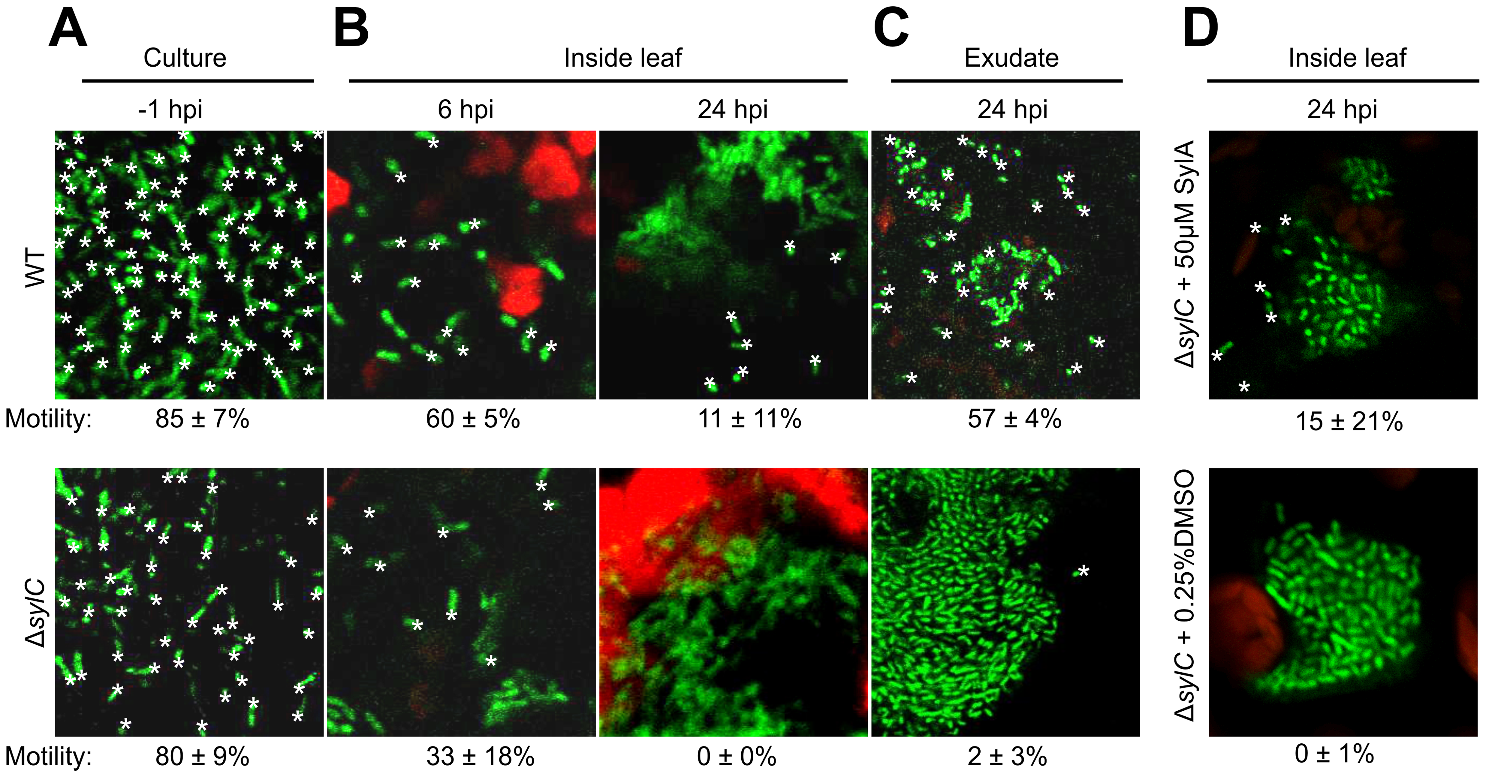
GFP/Luciferase labeled P. syringae as growth indication
Misas-Villamil et al 2013 PLOS Pathogens

Slide 17
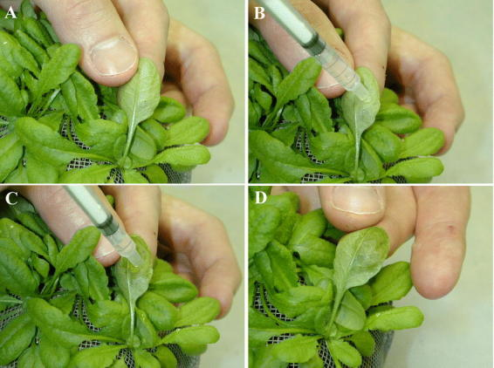
Syringe injection/infiltration of P. syringae
Katagiri et al. 2002 Arabidopsis Book

Slide 18
Syringe injection/infiltration of P. syringae
Yao & Withers et al. 2013 Chapter 6, Jasmonate Signaling: Methods & Protocols

Slide 19
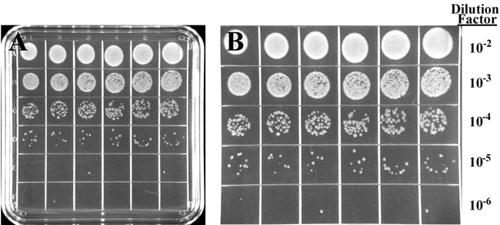
Quantify P. syringae growth
Katagiri et al. 2002 Arabidopsis Book

Slide 20
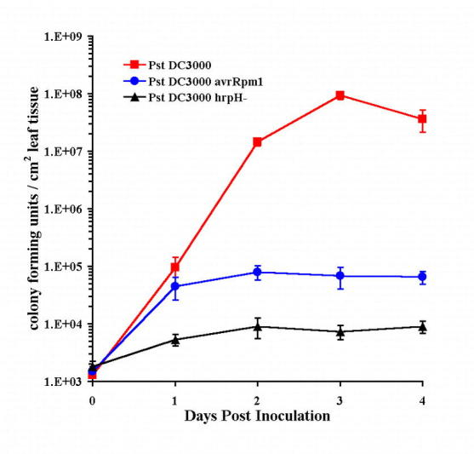
Quantify P. syringae growth
Katagiri et al. 2002 Arabidopsis Book

Slide 21
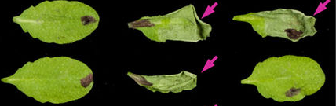
Determining gene-for-gene interactions using P. fluorescens Pf0-1 (EtHAn)
Pf0-1 lacks T3 effectors and T3SS
EtHAn contains a transgenic T3SS and can deliver effectors when encoded on plasmids
Saucet, Ma et al 2015 Nature comms

Slide 22
Take-home Puzzles:
Why do we use different methods for inoculation; what are the advantages for each method?
What is the main difference between spray/dipping and vaccum/syringae-infiltration? Hint: JA/coronatine (COR).

Slide 23
Protocol for syringe infiltration of P. fluorescens Pf0-1 - (1) Preparation of Bacterial Inoculum
1. Streak out bacteria from a −80 °C freezer stock onto a fresh
LM agar plate containing appropriate antibiotics.
2. Incubate the plate at 28 °C for 1 day.
3. The morning of the infiltration, resuspend bacteria in 10 mM MgCl₂.
4. Pellet bacteria by centrifugation at 2,500 × g for 10 min at
room temperature.
5. Remove supernatant and resuspend bacteria in 10 mM MgCl₂ to
a desired concentration depending on the inoculation technique
to be used.

Slide 24
Protocol for syringae infiltration of P. syringae - (2) Syringe Inoculation
1. For each bacterial strain, select four fully developed leaves of
each plant.
2. Mark the petioles with permanent ink for identification.
3. Using a 1-mL needleless syringe filled with bacterial suspension (OD 600 = 0.2 or 1 × 10 7 colony-forming units (CFU)/mL), gently infiltrate marked leaves on the abaxial surface.
4. Allow leaves to dry [we will use absorbing paper to gently wipe the left-over liquid on the leaf surface] and cover plants with a plastic wrap or a plastic dome to maintain high humidity.
5. Return plants to previous growth conditions for approximately
24 hours while HR cell death progresses.

Slide 25
THANK YOU!

Slide 26
Guidance
Split into four groups;
Step1: Dilute the A, B, and C Pseudomonas fluorescens Pf0-1 strains from the labelled-OD600 “stock” solution, using 10 mM MgCl₂.
Step2: Label your preferred leaves with different shapes/patterns, like “|, -, ×, ○…” for your different strains “A, B, C”. Write down your patterns accordingly on the handout paper.
Step3: Infiltrate your labelled leaves with your strains, according to your handout paper. Tomorrow, we will check the phenotype and write down the HR for each labelled strains.
Note: A, B, C will be one of Pf0-1 AvrRpt2, Pf0-1 AvrRps4 or Pf0-1 PopP2; we will reveal the results tomorrow.

Slide 27
Write down the symbol used for each strain next to the letter. Tomorrow, write down the number of leaves of a plant genotype infiltrated with a strain and the number of leaves showing HR
 | Strain infiltrated
Plant genotype |  | A | B | C
 | X | / | / | /
 | Y | / | / | /
 | Z | / | / | /

